Slide 1




7
Logical Functions
Prepared By :
Said Fawzy
Manager of Information Center
Tendering Department
Arab Contractors

Slide 2

1
Using the IF function
2
Using Nested IF
3
AND and OR Functions
4
IF Functions

Slide 3
1
Using the IF function

Slide 4


Slide 5

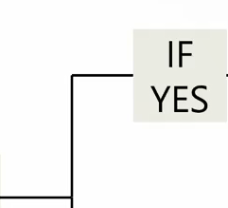
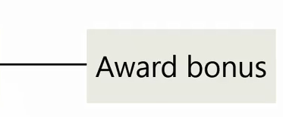
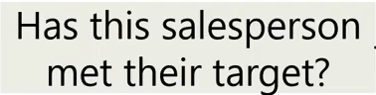
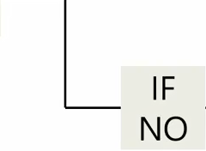
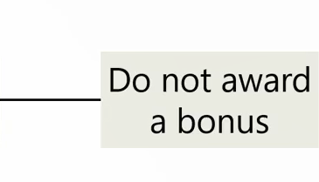

Slide 6


Slide 7
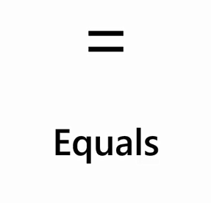

Slide 8
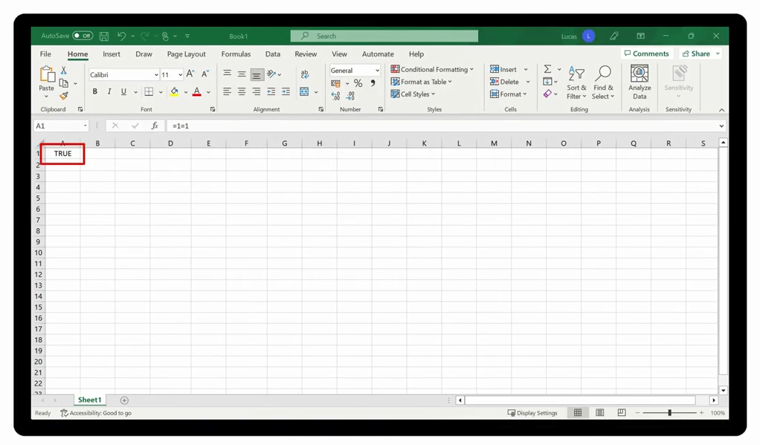

Slide 9
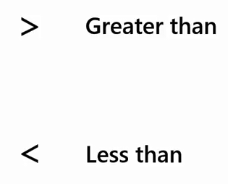

Slide 10
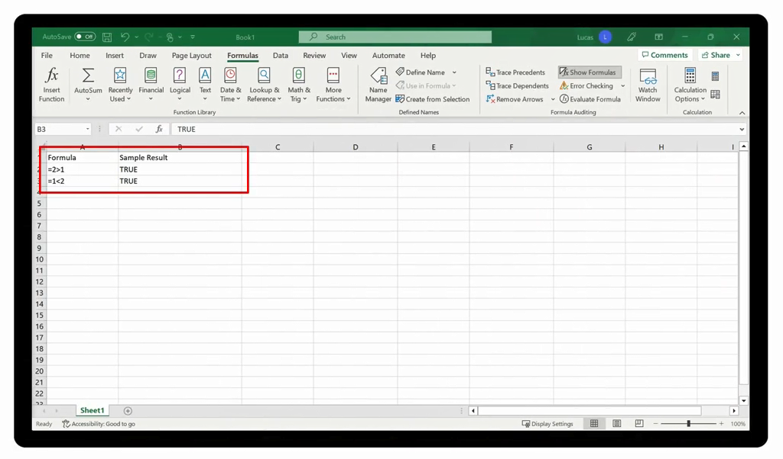

Slide 11
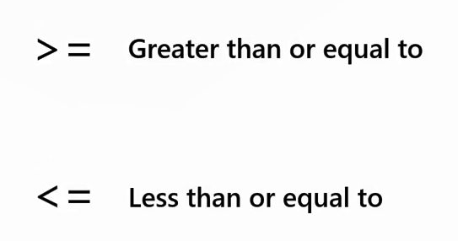

Slide 12
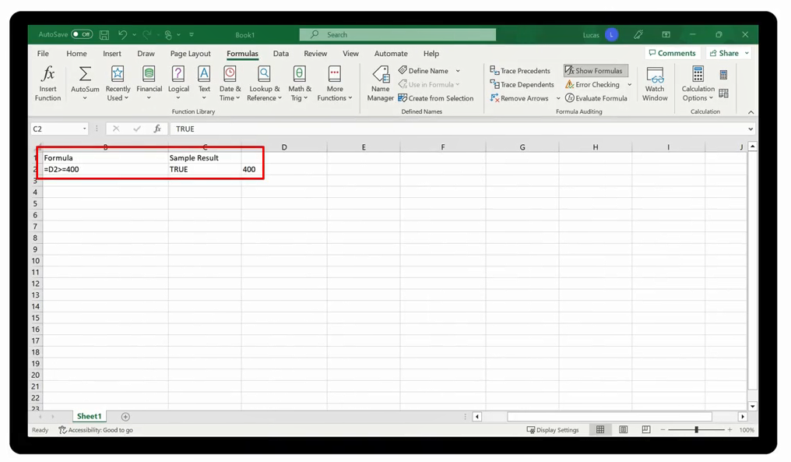

Slide 13
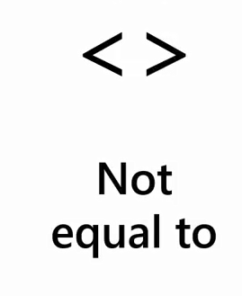

Slide 14
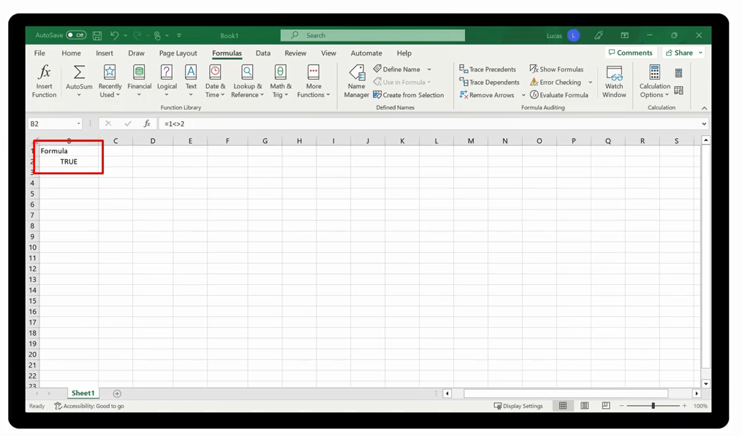

Slide 15
IF
You must give Excel 3 Pieces of information to work with IF

Slide 16

1

Slide 17
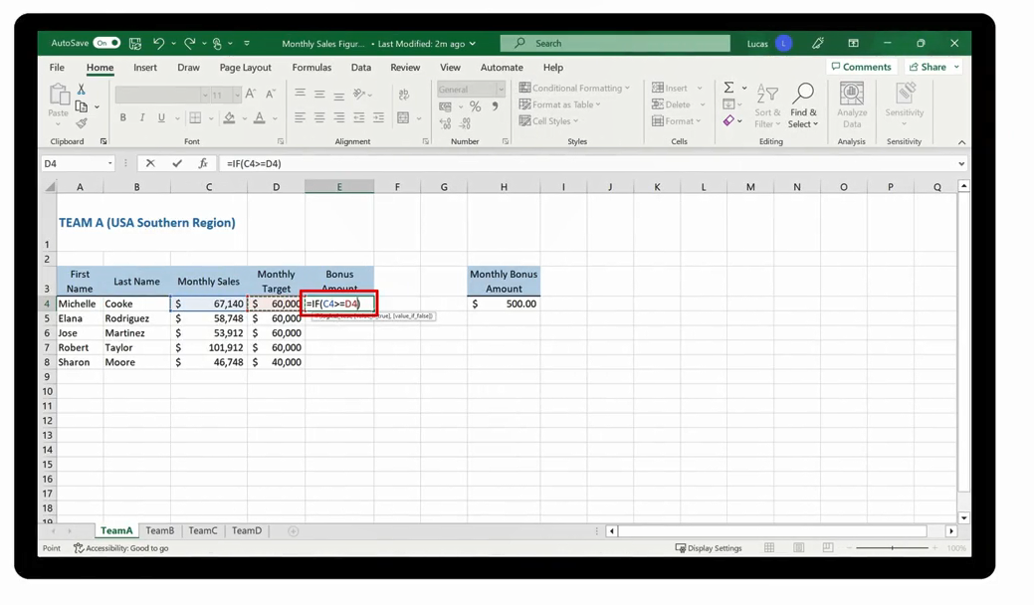

Slide 18
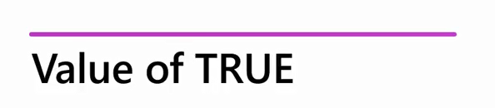
2

Slide 19
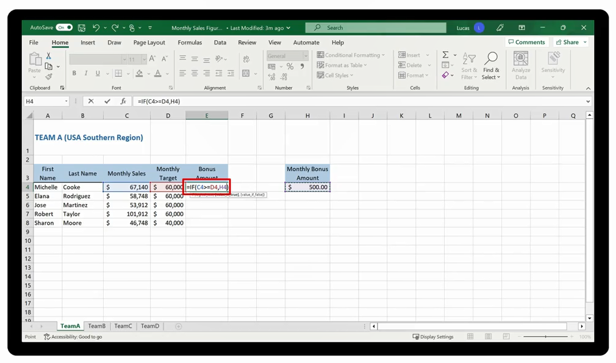

Slide 20
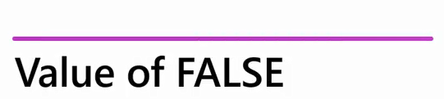
3

Slide 21
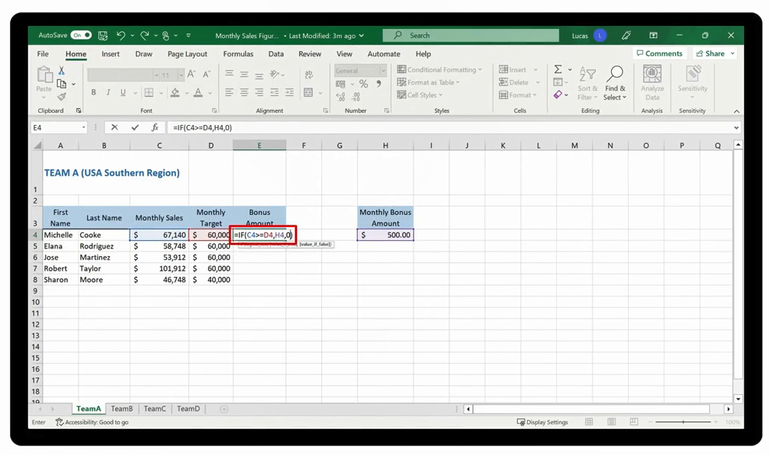

Slide 22

Demo 7 A
IF Function

Slide 23

Question 7-1
True or False: When a cell referenced in the logical test of an IF function formula does not meet the stated condition, Excel will instead perform the instruction detailed in the VALUE IF FALSE argument.
True
False

Slide 24

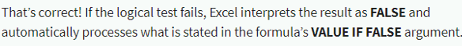
Question 7-1
True or False: When a cell referenced in the logical test of an IF function formula does not meet the stated condition, Excel will instead perform the instruction detailed in the VALUE IF FALSE argument.
True
False

Slide 25
2
Using Nested IF

Slide 26


Slide 27

Nesting functions is the technique of adding another function to the formula as an argument for the original function

Slide 28


1
2

Slide 29

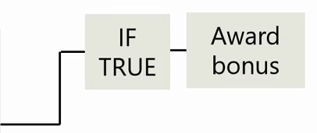
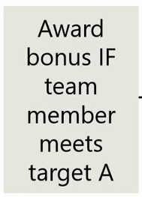
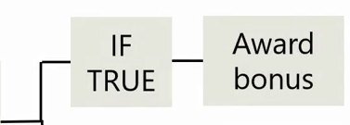
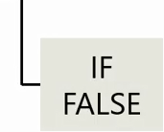
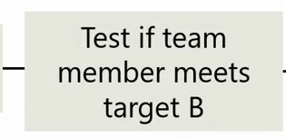
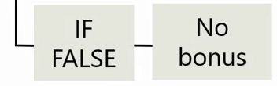

Slide 30
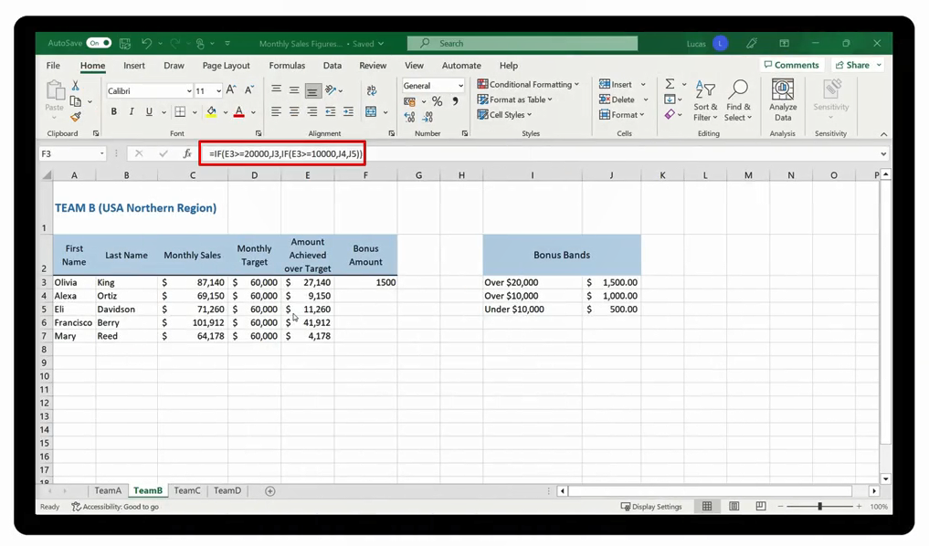

Slide 31

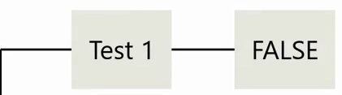
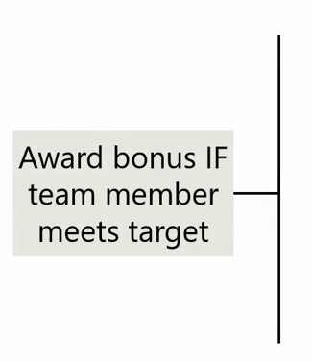
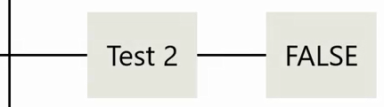
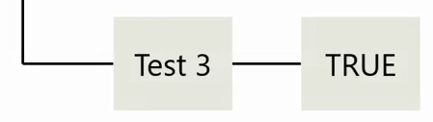
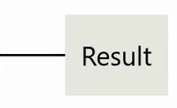

Slide 32
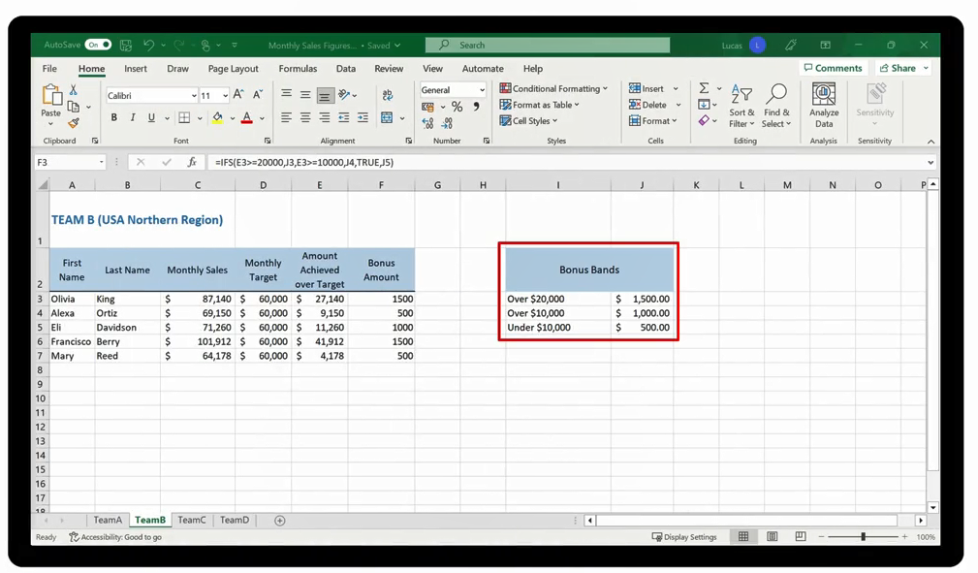

Slide 33
Demo 7 B
Nested IF and IFS Functions

Slide 34
Question 7-2
You have created a nested IF formula using three IF functions. How many closing parentheses do you need at the end of the formula?
One
Two
Three

Slide 35
Question 7-2
You have created a nested IF formula using three IF functions. How many closing parentheses do you need at the end of the formula?
One
Two
Three

Slide 36
3
AND and OR Functions

Slide 37
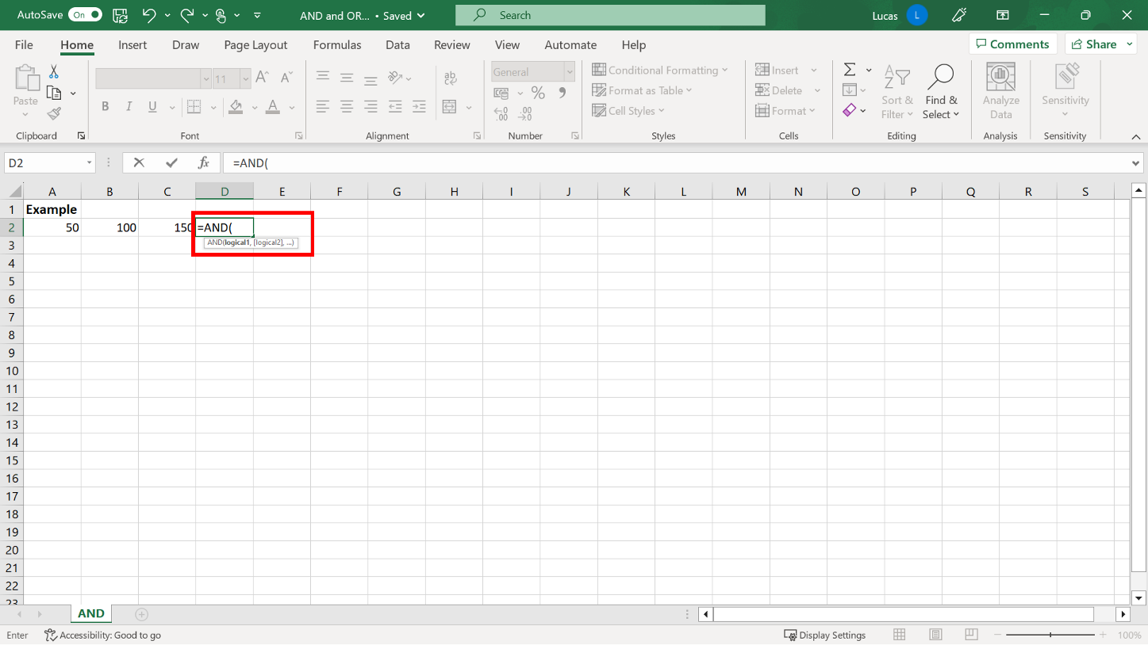
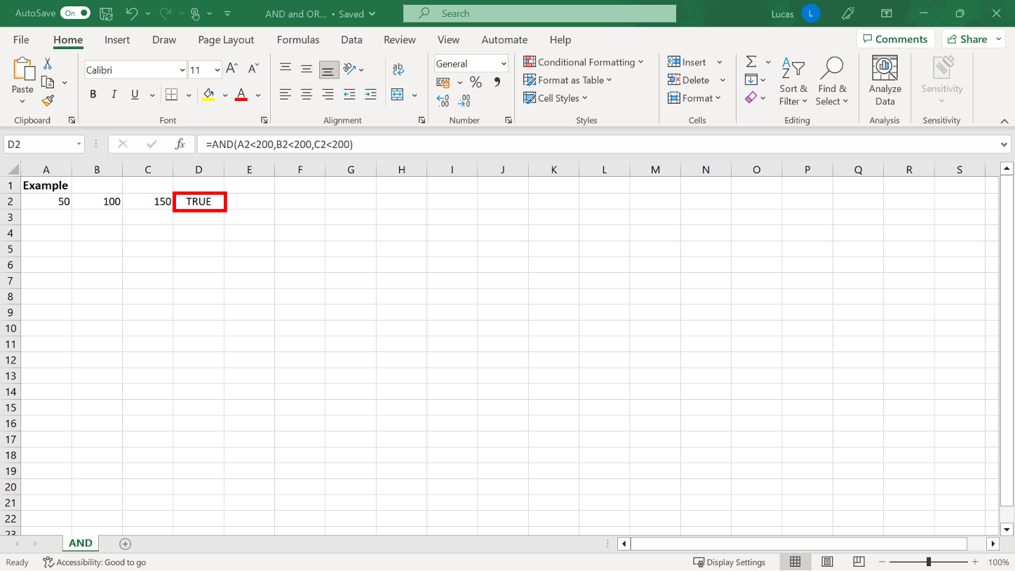
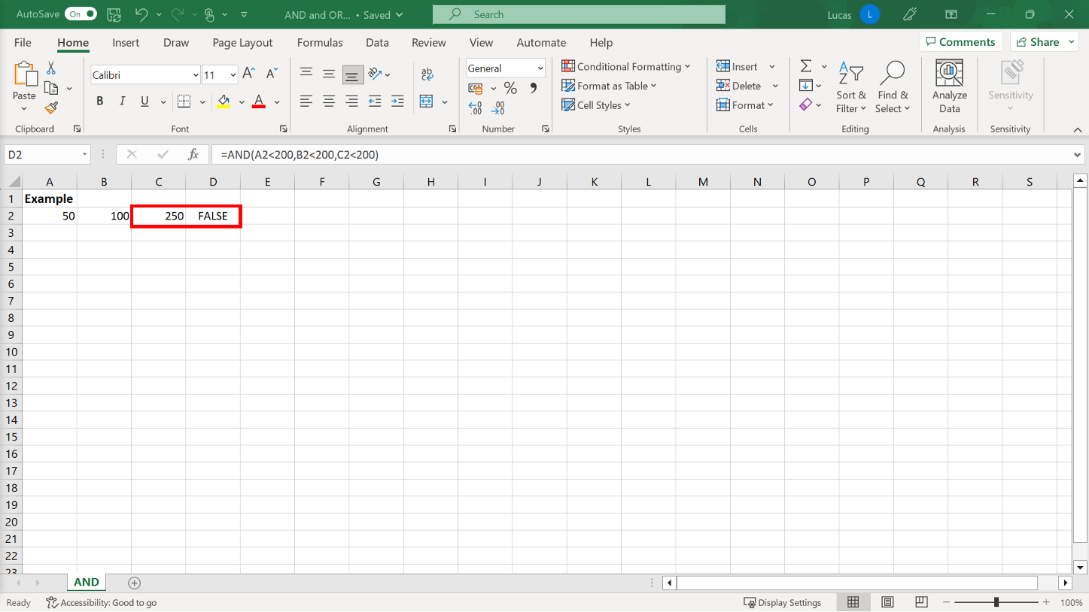
AND

Slide 38
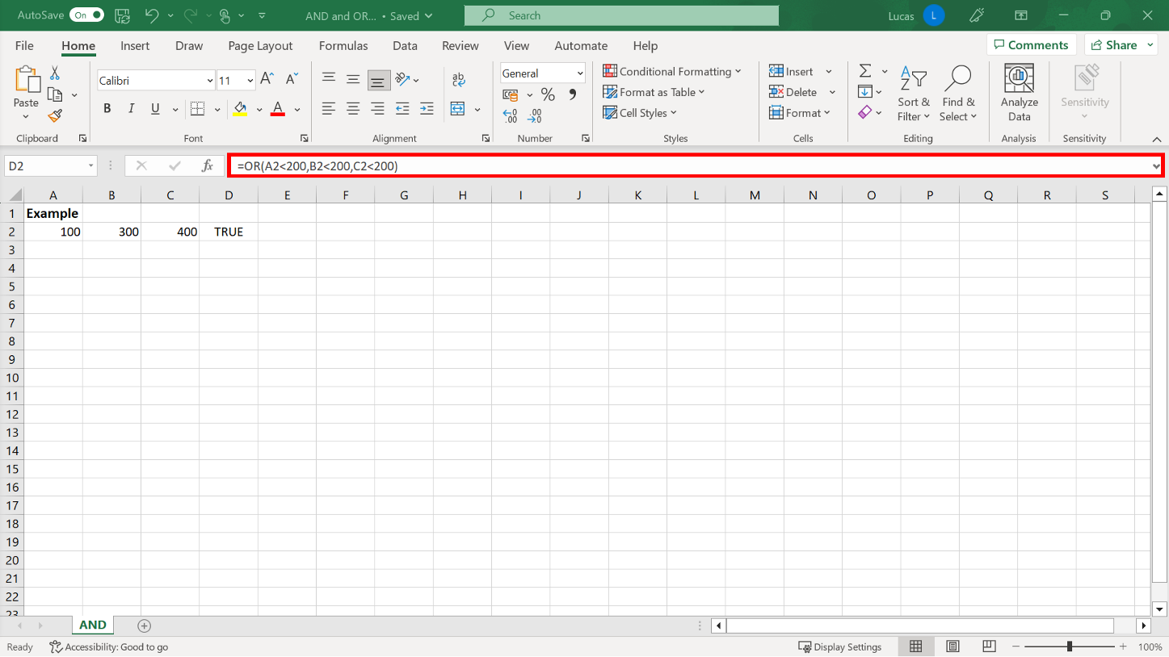
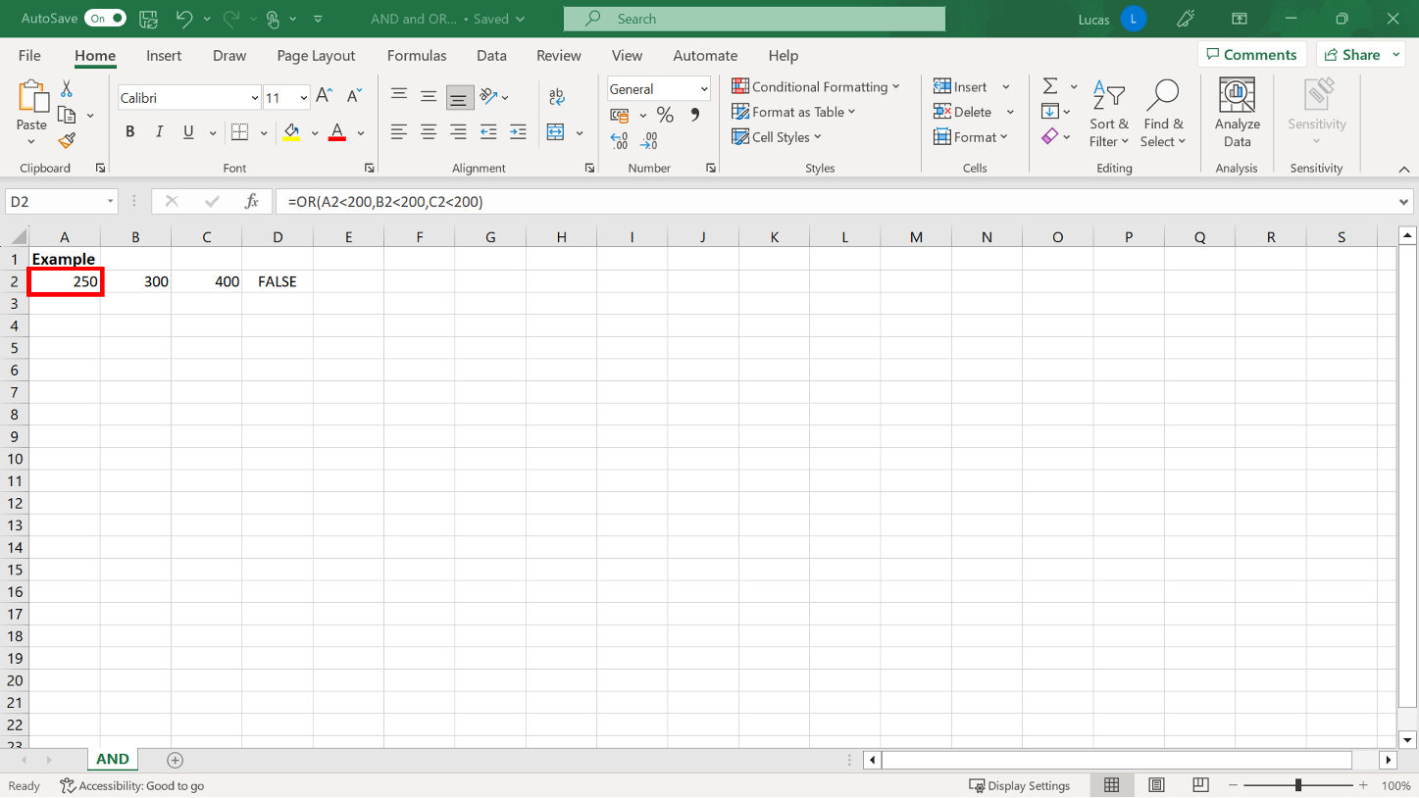
OR

Slide 39
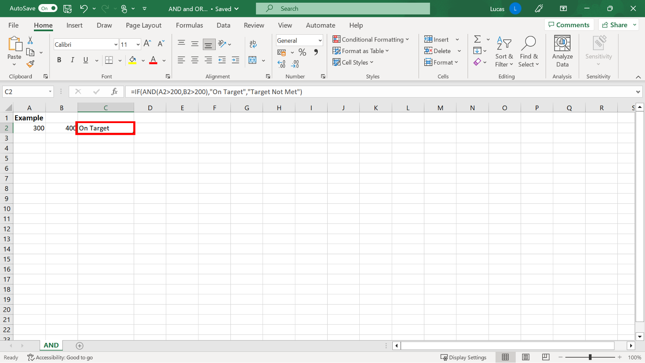
AND used with IF

Slide 40
4
IF Functions

Slide 41
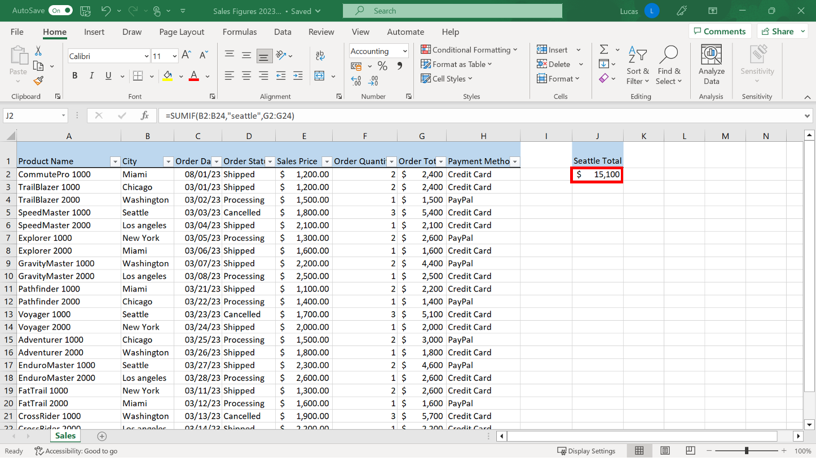
SUMIF

Slide 42

AVERAGEIF

Slide 43

COUNTIF

Slide 44

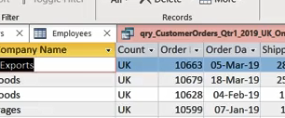
Exercise 7: Adding a data column using the IFS function.

Slide 45

Exercise Questions
Question 1
You created an IF function formula in cell H7 that was designed to display the correct percentage discount if the amount in G7 was greater than $10,000. In what format did you enter the percentage in the Value if true section of the formula?
10%
10
"10%"

Slide 46
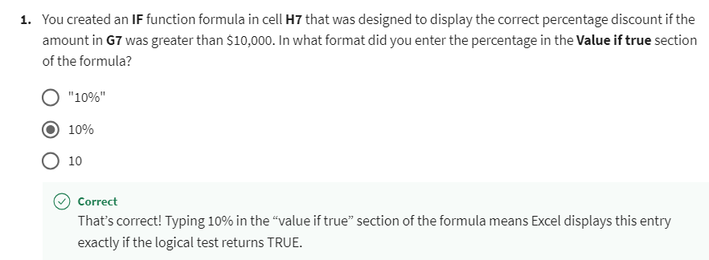
Exercise Questions

Slide 47
Exercise Questions
Question 2
True or False: When you created a formula in cell L7 to check and display the delivery charge for the region, you used IFS rather than IF because you needed to run more than two tests.
True
False

Slide 48
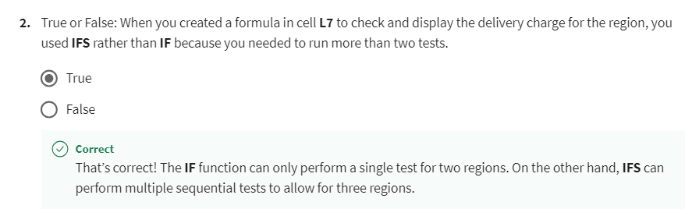
Exercise Questions

Slide 49
Exercise Questions
Question 3
You created a formula in H2 which used SUMIF to obtain a total for Region A entries only. What did you need to specify as the first argument in your formula?
The criteria entry
The criteria range
The SUM range

Slide 50
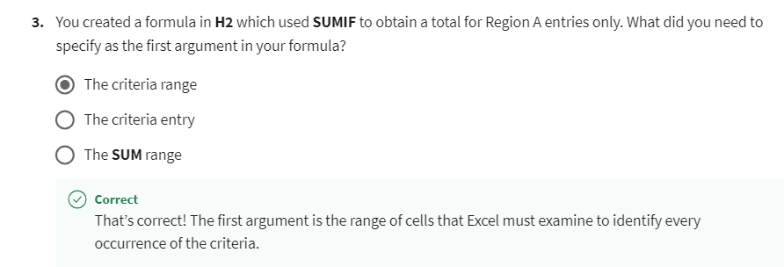
Exercise Questions

Slide 51


Slide 52

7
Question 1
Cell A2 of your worksheet contains a value of 250. What is the result of the following formula when added to your worksheet?
=IF(A2>300,10%,IF(A2>200,5%,0%))
5%
10%
0%

Slide 53
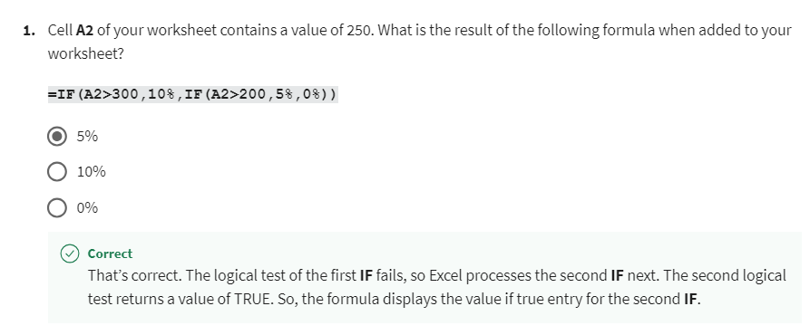
7
Explanation

Slide 54
7
Question 2
You create a formula using the IFS function to test for a series of alphabet characters. When typing the criteria to test for, what symbols should you add around each text character?
Single quotation marks.
Double quotation marks.
Parentheses.

Slide 55
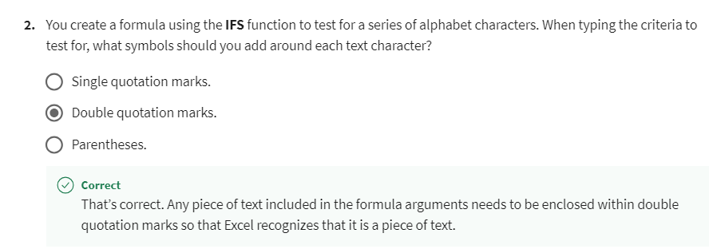
7
Explanation

Slide 56
7
Question 3
In your worksheet, cell A2 contains a value of 100. Cell B2 contains a value of 200, and C2 contains a value of 400. What is the result of the following formula when added to your worksheet?
=IF(OR(A2>=200,B2>=200),"Result 1",IF(C2>300,"Result 2","Result 3"))
Result 2
Result 3
Result 1

Slide 57
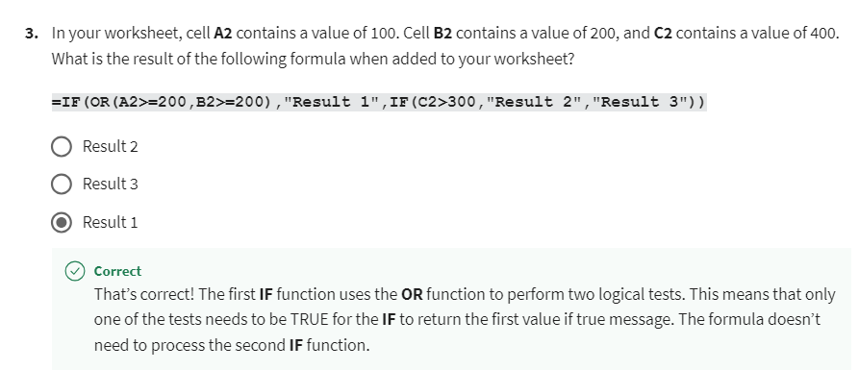
7
Explanation

Slide 58
7
Question 4
You create the following formula using the AVERAGEIF function:
=AVERAGEIF(A2:A50,"Chicago”,C2:C50)
What does the first argument of this function represent?
The criteria.
The average range.
The criteria range.

Slide 59
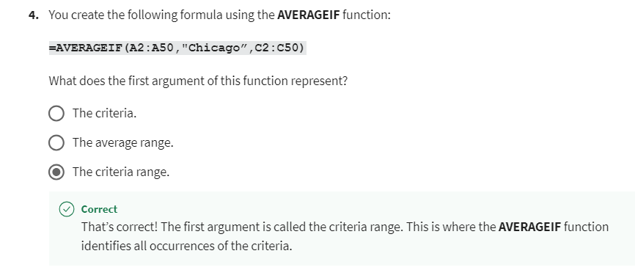
7
Explanation

Slide 60
7
Question 5
In your worksheet, cell A2 contains the value 100. Cell B2 contains a value of 200, and C2 contains a value of 400. What is the result of the following formula when added to your worksheet?
=IFS(A2>200,"Rate 1",B2>200,"Rate 2",C2>200,"Rate 3",TRUE,0)
Rate 3
Rate 2
Rate 1

Slide 61
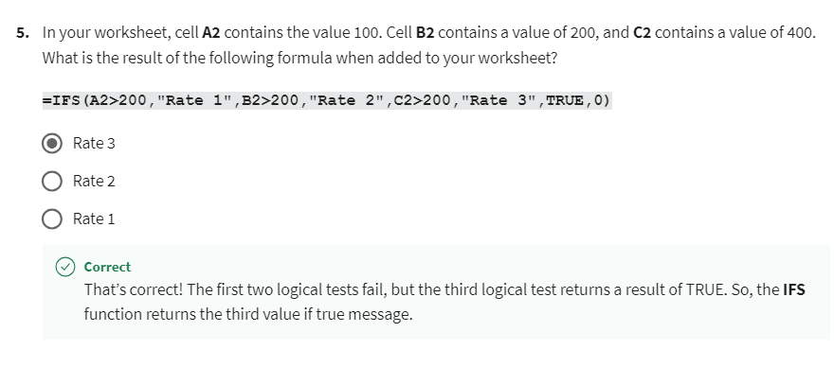
7
Explanation

Slide 62


